Slide 1
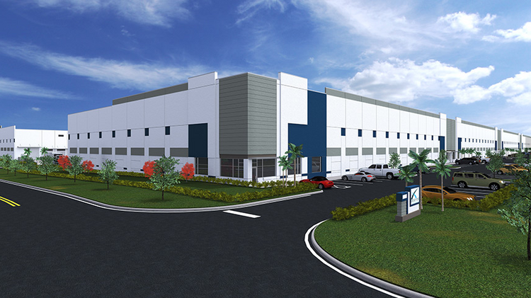
FOREIGN TRADE ZONE 281-65 DISTRIBUTION CENTER
Notes:
To change the image on this slide, select the picture and delete it. Then click the Pictures icon in the placeholder to insert your own image.

Slide 2
FOREIGN TRADE ZONE 281-65 CONSOLIDATION AND DISTRIBUTION CENTER TO THE CARIBBEAN AND LATIN AMERICA
PAS Cargo USA, Inc. just filled up a big chunk of Bridge Development Partners’ spec industrial project in Hialeah Gardens.
The company moved its headquarters from Doral to the newly opened Bridge Point Crossroads West project on the eastern side of Northwest 112th Avenue, where it lease 123,000 square feet.
Pas, founded in 2002, specializes in transporting and distribution cargo within Latin America and the Caribbean. Its last lease was for roughly 85,000 square feet at the 1990s-era Doral Logistics Center.

Slide 3
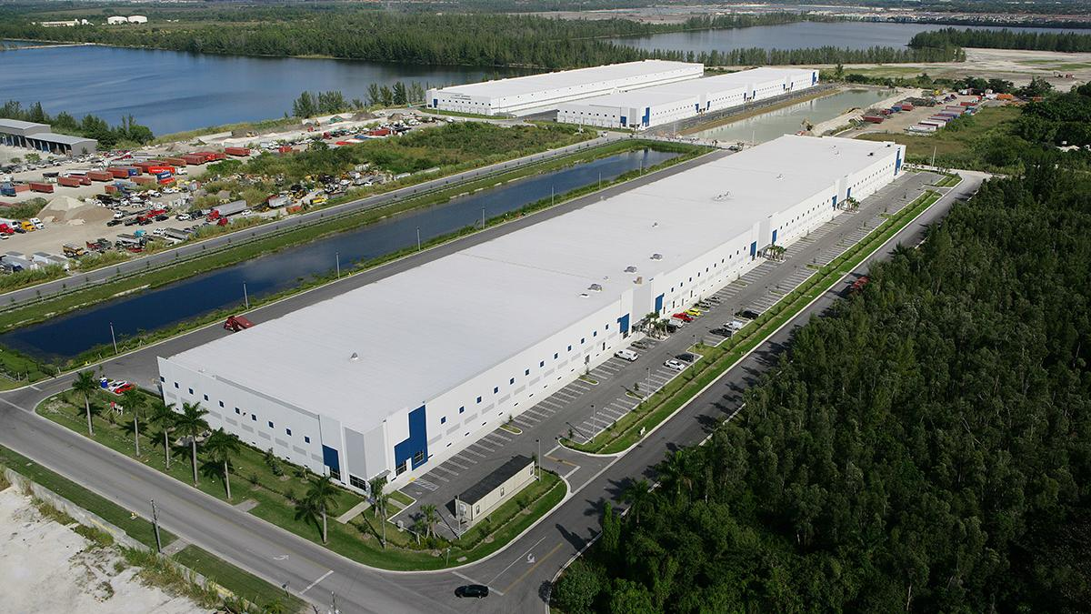
FACILITY PROFILE
**123,000 Square Feet
*41 Overhead Doors
*1 Ramp to receive motorized vehicles
*T-5 Lighting
*ESFR Sprinkler System
*40’ Clear Height
*24 Hour Monitored Alarm System
*Controlled Card Access System
*High Resolution Cameras Throughout the Facility
*Roaming Security Guard
*5 Level Racking System
FTZ-281-65
NVOCC
TSA APPROVED FACILITY
WCA AFFILIATED
T-CPAT CERTIFICATION PROCESS

Slide 4
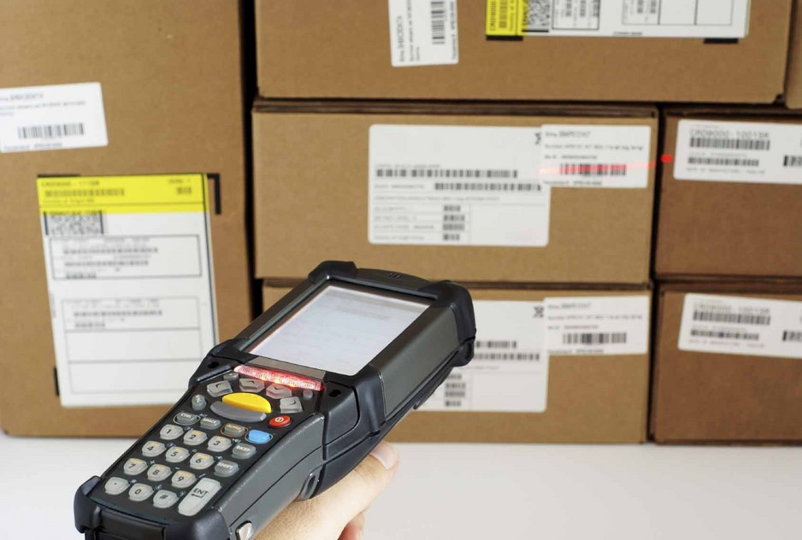
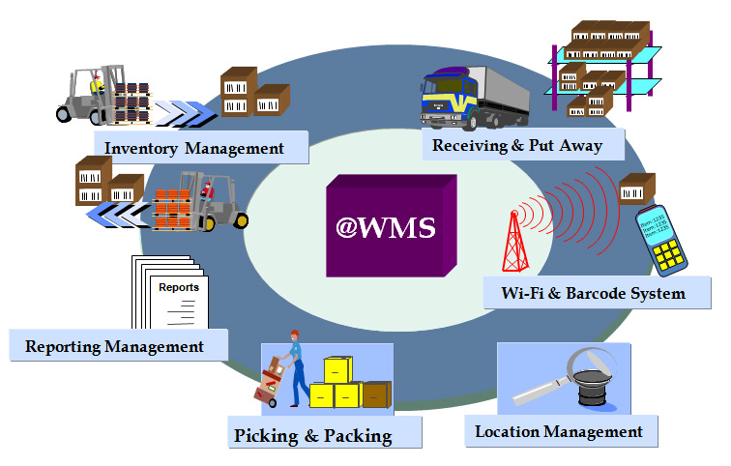
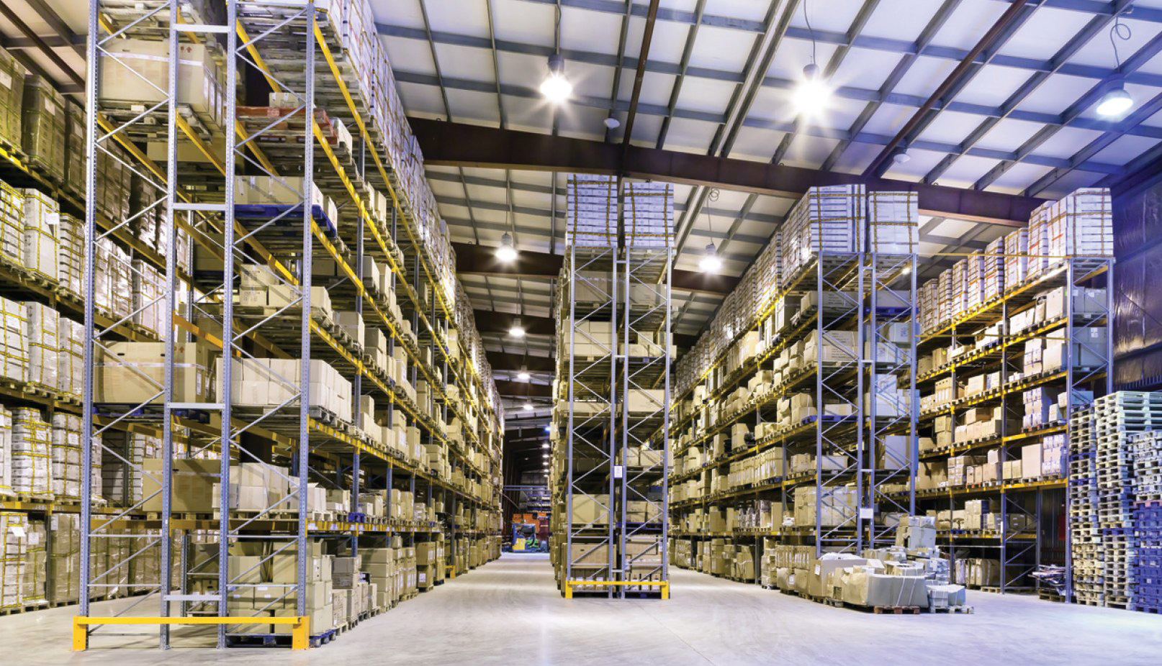
Pas Cargo USA, Inc. Foreign Trade Zone 281-65 Distribution Center (Services Provided in our facility)
Container Loading & Un-Loading
Domestic and Bonded Storage –Short Term or Long Term
Consolidation Point for Domestic or Export Projects
Labeling & Price Tagging
Labeling & Sorting
Kitting & Bundling
Transfers
Inventory Management
KPI
Cycle Counts
Testing
Quality Checks
DG-Hazmat Consultants
FTZ-281 Consulting Services

Slide 5
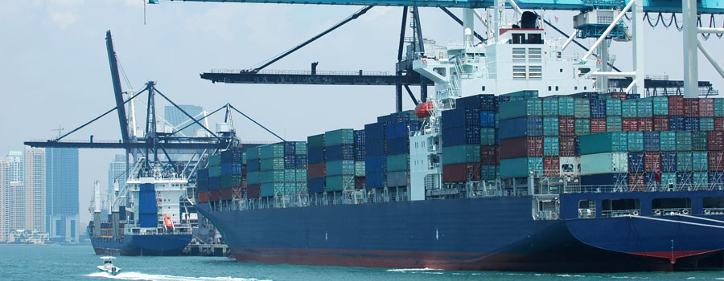
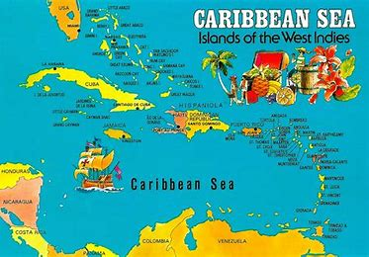
Services provided: Ocean freight Air freight Warehousing Project break bulk Charters air and ocean GSA for airlines Current markets served as follows: Barbados Grenada St. Lucia Jamaica Antigua Trinidad Guyana Dominica Panama Costa Rica St. Kitts Anguilla We are a licensed NVOCC and TSA approved FTZ also affiliated with WCA group of worldwide forwarders capable of container movement globally.
Pas Cargo USA, Inc. Transportation and Documentation Services Provided:

Slide 6
FOREIGN TRADE ZONE-281-65 281-6510901 NW 146th Street, Suite 8, Hialeah Gardens FL 33018 Tel (305)994 7232 Fax (305)994 7559
STATE OF THE ART DISTRIBUTION CENTER AND FOREIGN TRADE ZONE-281-65
LOCATED CLOSE TO THE AIRPORTS & PORTS: Port Miami, Port Everglades, Miami International Airport, and Ft. Lauderdale Airport

Slide 7
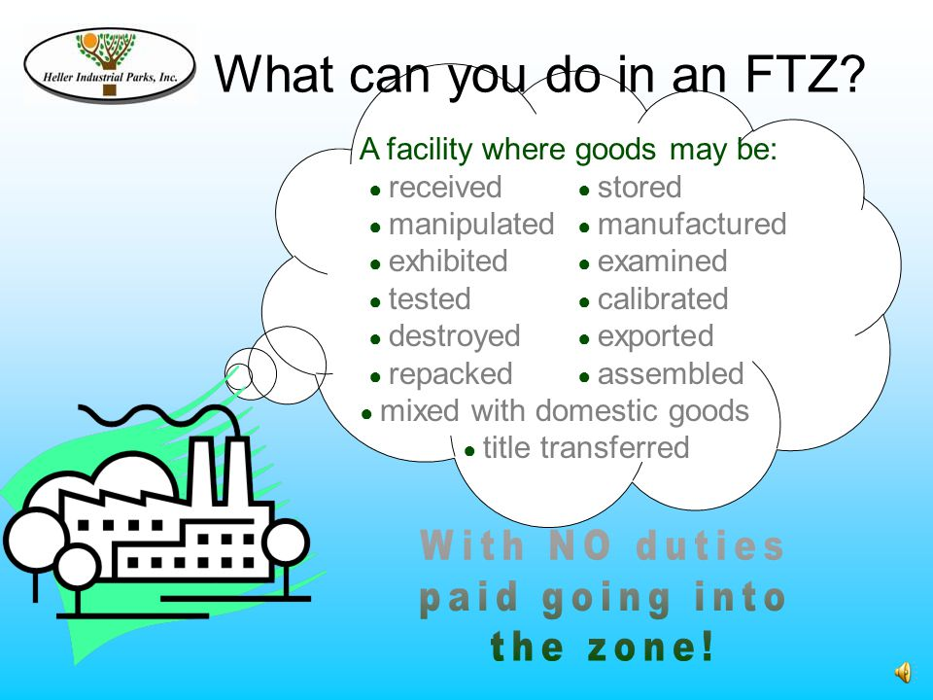
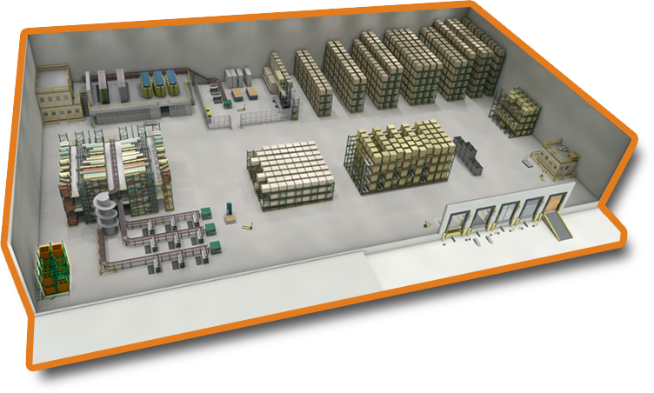
What we can do in our Facility as a Foreign Trade Zone 281-65

Slide 8
FTZ-281 vs. Traditional Bonded Cargo Warehouse

